Slide 1
Recommendation System Project
Final Project
Done By
Rahul Raje

Slide 2





Frameworks Used
Framework : Django web framework
Data Base : Mongo DB
CSS Framework : Bootstrap
Text Editor : Atom

Slide 3

Datasets used
For movies - Movie Genre dataset ~ 40,000 movies
For books - Book covers dataset ~ 32,000 books
For animes – Anime dataset ~ 20,000 animes

Slide 4
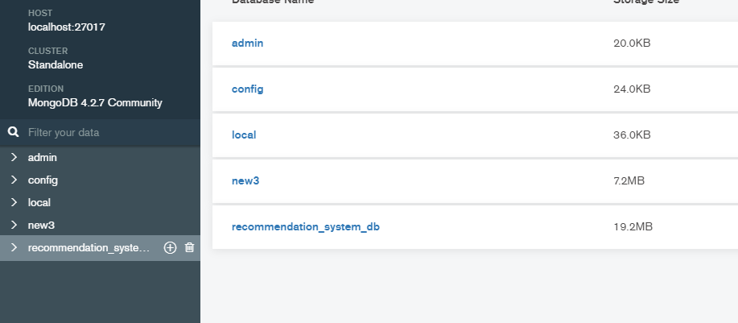
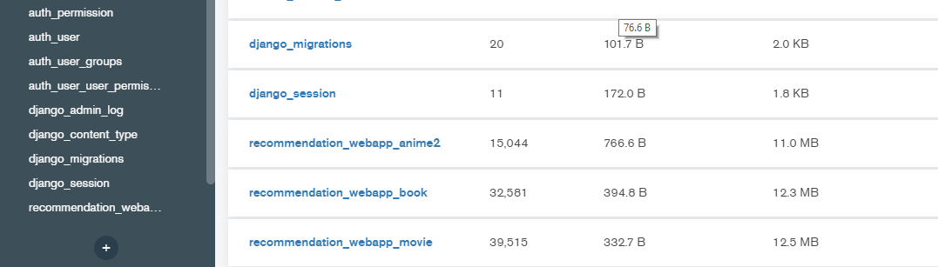

Slide 5

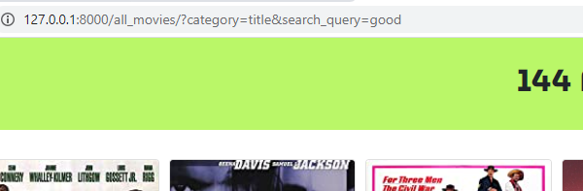
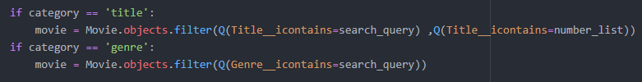
Search bar Algorithm

Slide 6
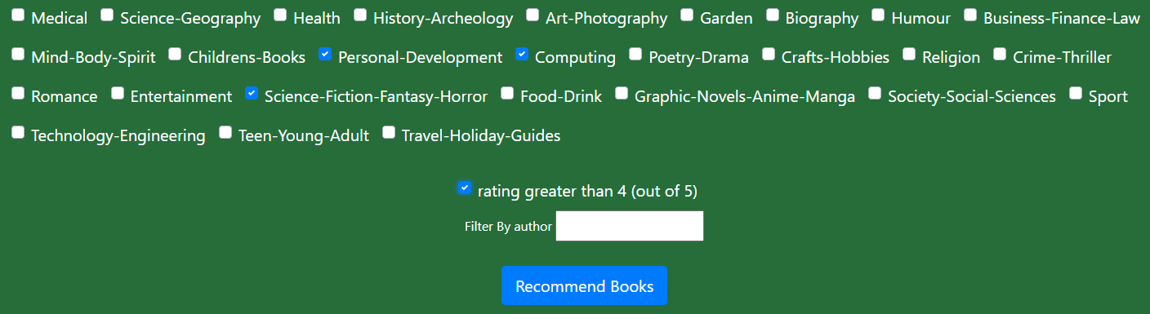
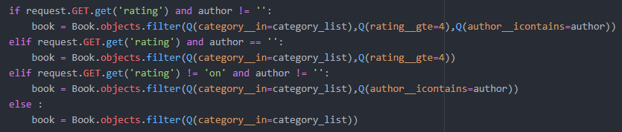
Category – search algorithm

Slide 7
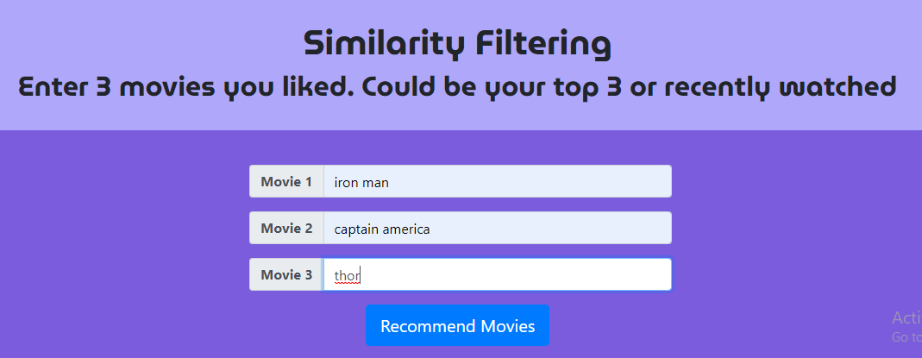
Similarity based filtering

Slide 8
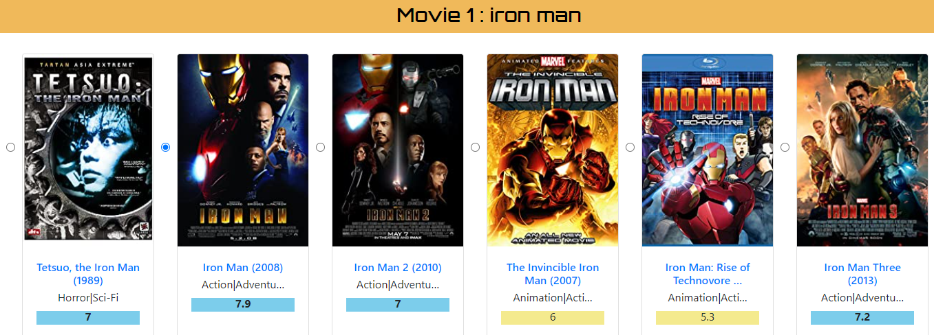
Iron man (2008) selected
rating: 7.9
Genre: action, adventure

Slide 9
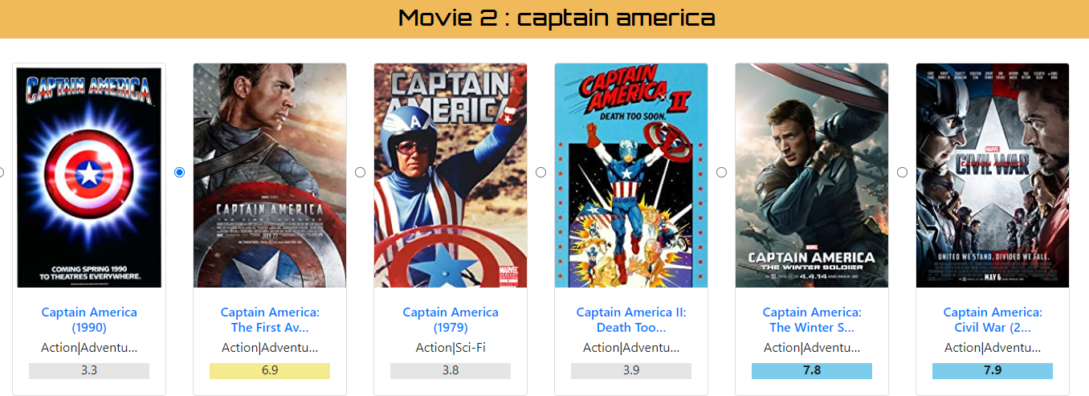
Captain America
Rating : 6.9
Genre: action, adventure,..

Slide 10
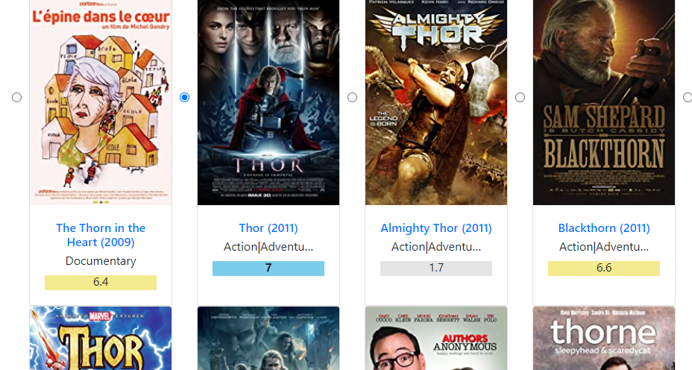
Thor
Rating: 7
Genre: action, adventure,..

Slide 11
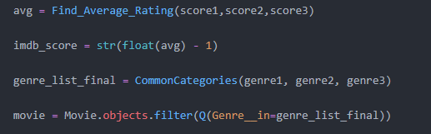
Final filtering
Average_rating = Avg(rating1,rating2,rating3)
= 7.3
Score = 7.8 – 1 = 6.3
Unique_genre_list = CommonCategories(genre_list1,genre_list2,genre_list3)

Slide 12
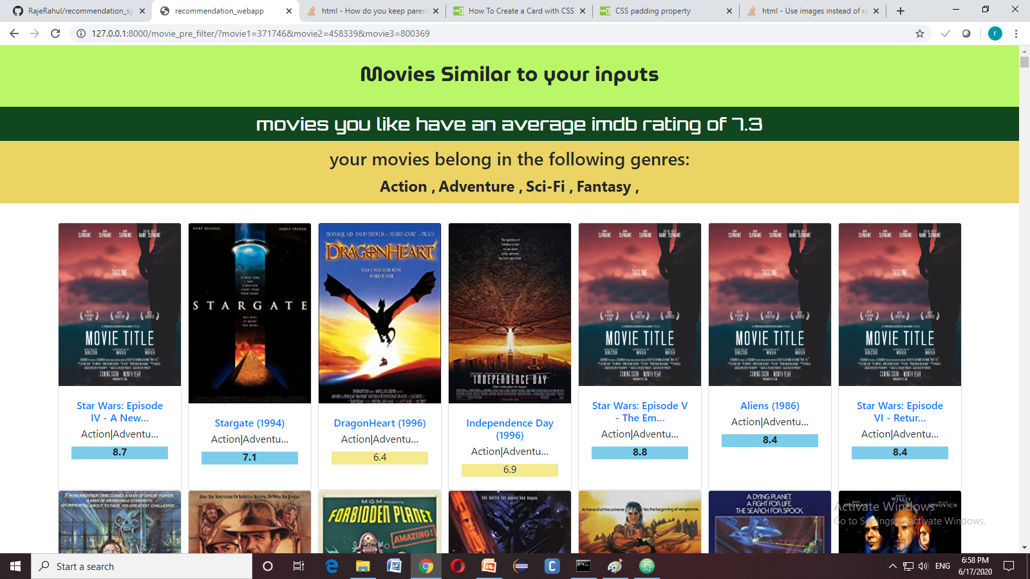

Slide 13
